Slide 1
EXCEL PROJECT
This complete project is about the sales of the company name Vrinda store and using the data, came up with the valuable insights in a dashboard.
This complete data set has 21 columns and total 31048 rows.
OBJECTIVE: Vrinda store wants to create an annual sales report for 2022.So, that,
Vrinda can understand their customers and grow more sales in 2023.

Slide 2
QUESTIONS BASED ON DATASET
Compare the sales and order using single chart?
Which month got highest sales and orders?
Who purchased more either men or women in 2022?
What are different order status in 2022?
List top 5 states contributing to sales?
Relation between age and gender based on number of orders?
Which channel is contributing to maximum sales?
Highest selling category?

Slide 3
Compare the sales and order using single chart?
HIGHEST – Order: 2700 Sales:1.94M
LOWEST – Order: 2400 Sales:1.68M

Slide 4
Who purchased more either men or women in 2022?
HIGHEST -Women
LOWEST - Men

Slide 5
What are different order status in 2022?
Cancelled: 844
Delivered: 28641
Refunded: 517
Returned: 1045

Slide 6
List top 5 states contributing to sales?

Slide 7
Relation between age and gender based on number of orders?

Slide 8
Which channel is contributing to maximum sales?

Slide 9
CONCLUSION
SAMPLE INSIGHTS:
Women are more likely to buy compared to men (~65%)
Maharashtra, Karnataka and Uttar Pradesh are top 3 states (~35%)
Adult age group (30-49 years) is max contributing (~50%)
Amazon, Flipkart and Myntra channels are max contributing (~80%)
CONCLUSION:
Target women customers of age group (30-49 yrs) living in Maharashtra, Karnataka and Uttar Pradesh by showing ad/offer/coupons available on Amazon, Flipkart and Myntra.

Slide 10
DATA SOURCE
DATA SET
https://bit.ly/3X381ok

Slide 11
INTERACTIVE DASHBOARD

Slide 12
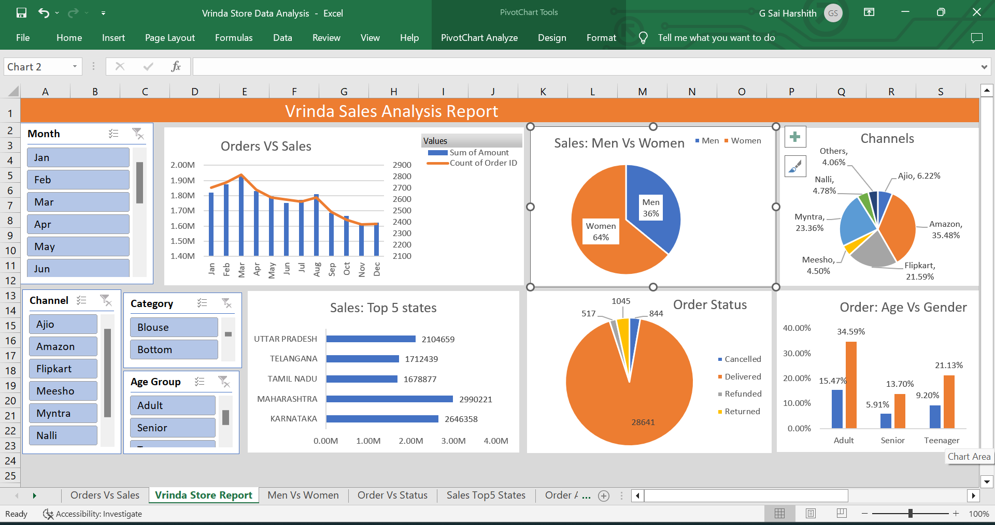

Slide 13
THANK YOU

